Slide 1


Operation Analytics and Investigating Metric Spike
By Satyashree Sahu Pawar

Slide 2

Operation Analytics and Investigating Metric Spike
By Satyashree Sahu Pawar

Slide 3
Project Description
The primary purpose of this project is to understand and optimize various aspects of the company's operations. This includes investigating job reviews over time, analyzing throughput trends, assessing language usage patterns, and detecting duplicate rows in the data. The insights derived from these analyses will empower different departments, such as operations, support, and marketing, to make informed decisions and improve overall organizational performance.

Slide 4
Approach
SQL Query Development:
Developed SQL queries tailored to each task's objectives.
For "Jobs Reviewed Over Time," aggregated data to calculate the number of jobs reviewed per hour for each day in November 2020.
In "Throughput Analysis," calculated the 7-day rolling average of throughput using SQL window functions.
For "Language Share Analysis," utilized SQL to determine the percentage share of each language over the last 30 days.
In "Duplicate Rows Detection," crafted an SQL query to identify and display duplicate records within the job_data table.
Documentation and Explanation:
Documented the SQL queries, ensuring clarity and transparency in the analysis process.
Provided explanations and interpretations of the results, highlighting key insights and trends derived from the data.
Data Exploration:
Examined the structure and contents of the provided datasets, with a specific focus on the job_data table.
Verified data types, checked for missing values, and assessed overall data quality to ensure accurate analysis.
Understanding Objectives:
Reviewed project objectives and tasks to gain a clear understanding of the analysis requirements.
Identified key focus areas, including job reviews, throughput analysis, language share, and duplicate row detection.

Slide 5



Tech-Stack Used
Database Management System (DBMS):
MySQL was utilized to store and manage the datasets.
Data Visualization Tools
Data visualization tools Power BI, is used to create charts and graphs for visual representation of the analysis results
Spreadsheet Software:
Spreadsheet software like Microsoft Excel is used for initial data exploration, cleaning, and basic analysis before transitioning to SQL for more complex queries.

Slide 6
Insights case study 1
Jobs Reviewed Over Time:
Insight: Calculated the number of jobs reviewed per hour for each day in November 2020.
Observation: Identified trends and patterns in job reviews, allowing for a detailed understanding of daily workflow variations.
Throughput Analysis:
Insight: Calculated the 7-day rolling average of throughput (number of events per second).
Observation: Recognized the importance of smoothing out short-term fluctuations, providing a more stable representation of overall throughput trends. This approach is preferred for better trend analysis compared to daily metrics.
Language Share Analysis:
Insight: Calculated the percentage share of each language in the last 30 days.
Observation: Revealed language usage patterns, aiding in resource allocation and strategic decision-making for content creation or translation efforts.
Duplicate Rows Detection:
Insight: Identified duplicate rows in the job_data table.
Observation: Recognized potential data quality issues and the need for data cleansing, ensuring accurate analysis and reporting.

Slide 7
Insights case study II
Weekly Engagement Per Device:
Leveraged SQL queries to measure weekly user engagement per device.
Email Engagement Analysis:
Employed SQL queries to analyze user engagement with the email service.
Weekly Retention Analysis:
Developed SQL queries to calculate weekly retention of users based on sign-up cohorts.
Weekly User Engagement:
Utilized SQL queries to measure weekly user engagement.
Identified device-specific trends, informing device-targeted strategies.
Assessed the effectiveness of email campaigns and identified opportunities for improvement.
Evaluated user loyalty and identified potential drop-off points in the user journey.
Monitored user activity patterns to gauge product popularity and identify potential areas for improvement.

Slide 8
Case Study 1: Job Data Analysis

Slide 9

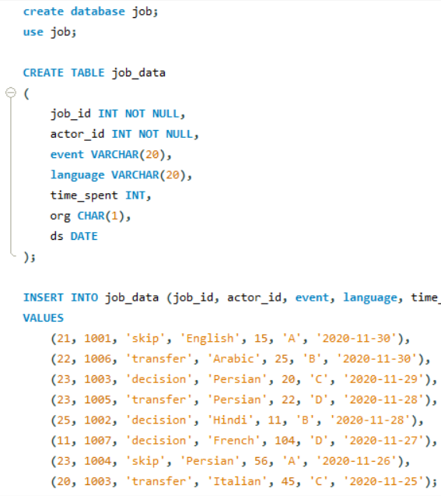
Create Database and
Table

Slide 10
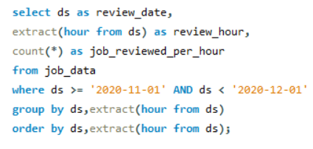
Jobs Reviewed Over Time
review_date | review_hour | job_reviewed_per_hour
25-11-2020 | 0 | 1
26-11-2020 | 0 | 1
27-11-2020 | 0 | 1
28-11-2020 | 0 | 2
29-11-2020 | 0 | 1
30-11-2020 | 0 | 2
Number of jobs reviewed per hour for each day in November 2020.

Slide 11
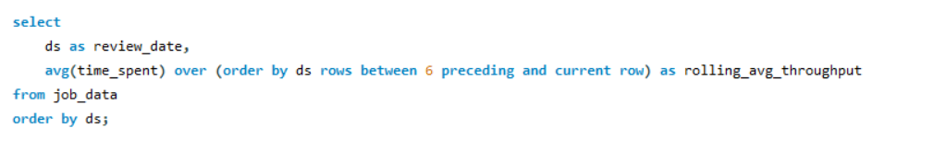
Throughput Analysis:
Calculate the 7-day rolling average of throughput (number of events per second).

Slide 12
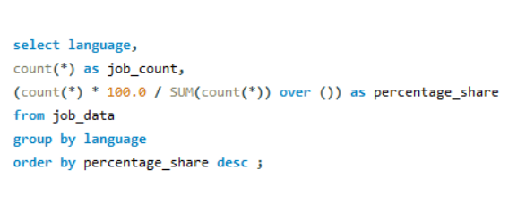
Language Share Analysis
Calculate the percentage share of each language in the last 30 days

Slide 13
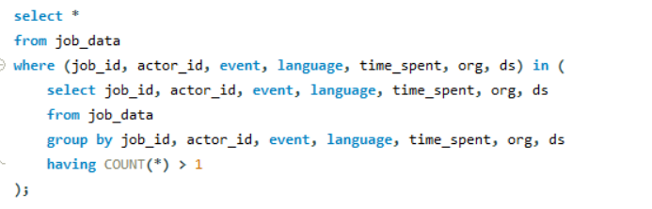
Duplicate Rows Detection
job_id | actor_id | event | language | time_spent | org | ds
NIL
Identify duplicate rows in the data.

Slide 14
Case Study 2: Investigating Metric Spike

Slide 15
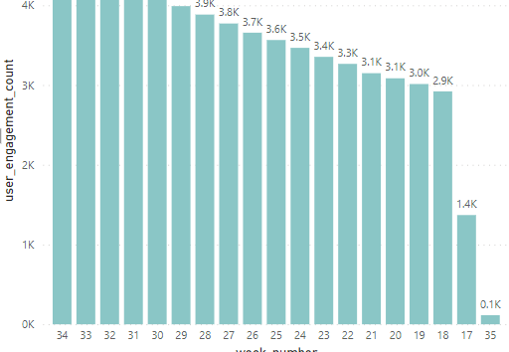
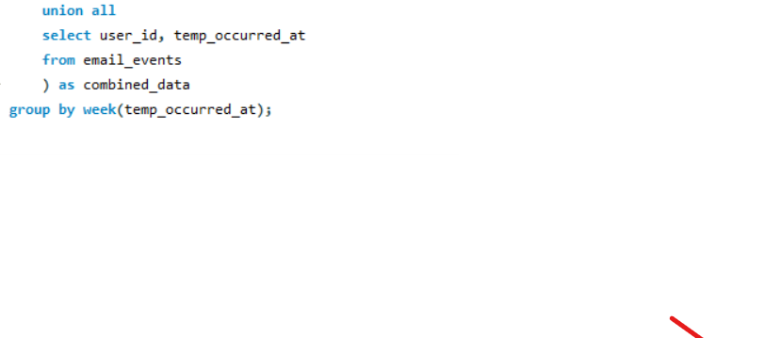
Weekly User Engagement:
Measure the activeness of users on a weekly basis

Slide 16
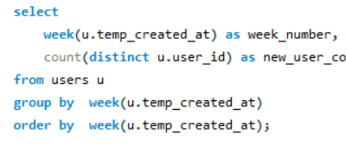
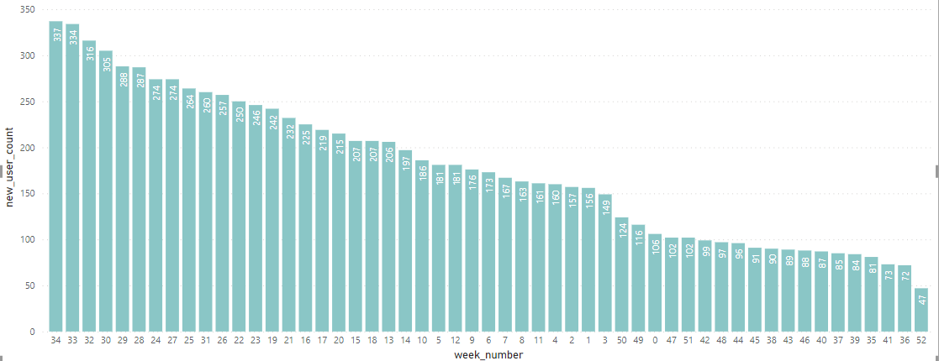
User Growth Analysis:
Analyze the growth of users over time for a product.

Slide 17
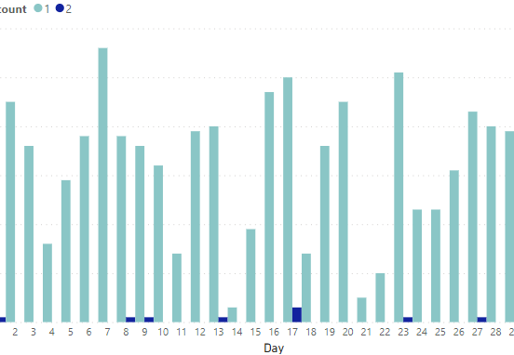
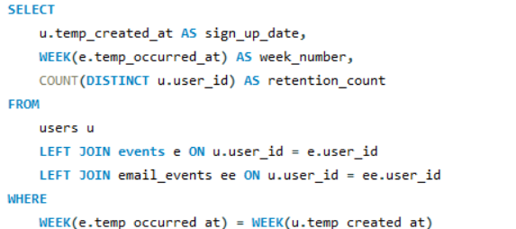
Weekly Retention Analysis
Analyze the retention of users on a weekly basis after signing up for a product.

Slide 18
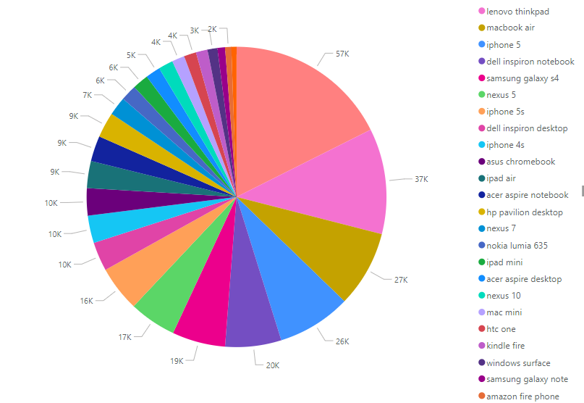
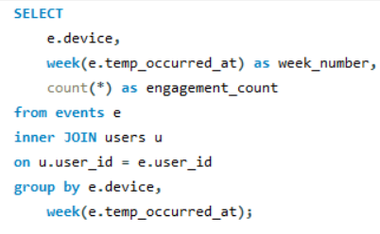
Weekly Engagement Per Device:
Measure the activeness of users on a weekly basis per device.

Slide 19
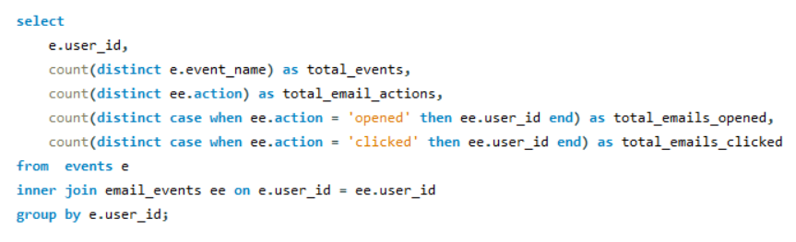
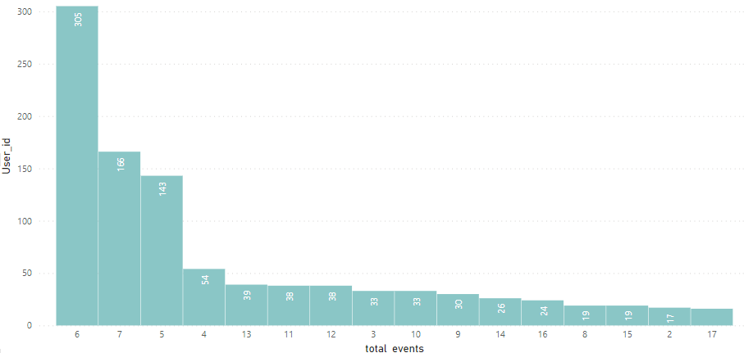
Email Engagement Analysis
Analyze how users are engaging with the email service.

Slide 20
Result
Throughput Analysis Insights:
By calculating the 7-day rolling average of throughput, I gained a nuanced understanding of system performance trends. This approach allowed for the identification of underlying patterns, smoothing out short-term fluctuations. The insights derived from this analysis have contributed significantly to decision-making by providing a more stable representation of throughput metrics. This approach proved valuable in assessing long-term performance, aiding in strategic planning and resource allocation.
Language Share Analysis Impact:
The calculation of the percentage share of each language over the last 30 days provided key insights into language usage patterns. This analysis has directly influenced decision-making related to content creation and translation efforts. Understanding the distribution of languages over time has enabled the organization to allocate resources more efficiently, ensuring content is tailored to the preferences and needs of the diverse user base. The data-driven language share analysis has proven instrumental in optimizing global communication strategies.
Duplicate Rows Detection for Data Quality:
Identifying and addressing duplicate rows in the job_data table significantly enhanced data quality. This not only contributed to accurate analyses but also instilled confidence in the reliability of the data. The emphasis on data quality has reinforced the importance of thorough data cleansing processes in decision-making. By ensuring the integrity of the dataset, the project has elevated the overall quality of insights derived from the analysis, reinforcing the importance of maintaining high standards in data management practices.

Slide 21


